Slide 1
Access Control

Slide 3
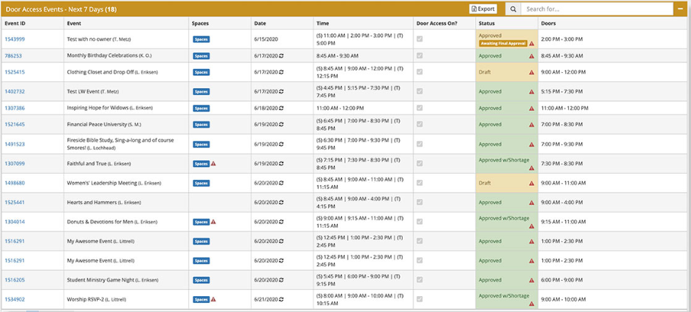

Slide 4


